Slide 1
Long Range Building Program Process Presentation
Board of Regents Meeting
September 19, 2013
MT Tech - Butte

Slide 2
Montana University System LRBP Process
Participants in the LRBP Process
Regents
Commissioner of Higher Education
Campus
Legislative staff
Budget Office

Slide 3
Montana University System LRBP Process
Continuous Planning Process
Campuses Track & Compile Projects
Deferred maintenance
Energy
Modernization
New Capital Needs
Campuses Prioritize Needs

Slide 4
Montana University System LRBP Process

Slide 5
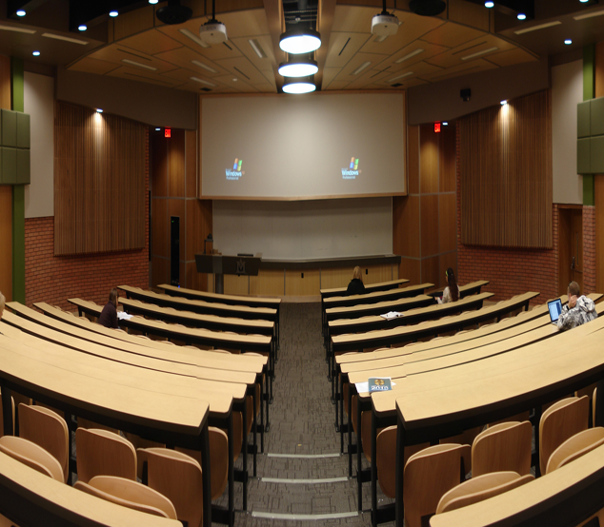
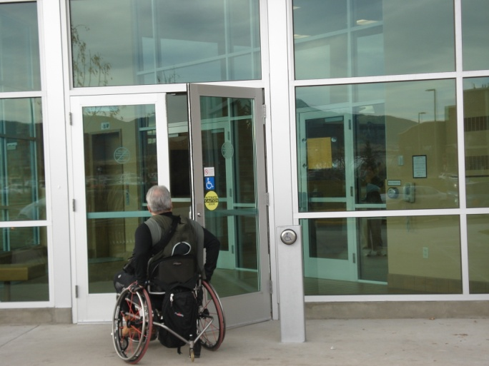
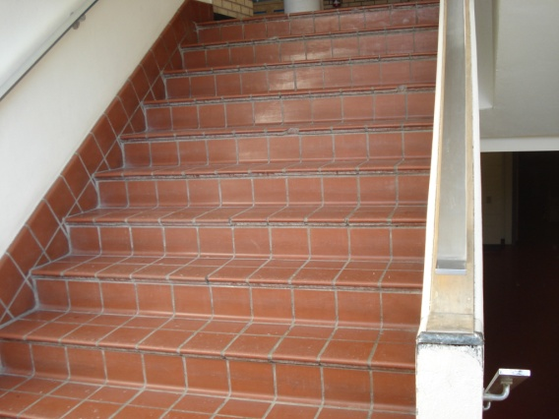
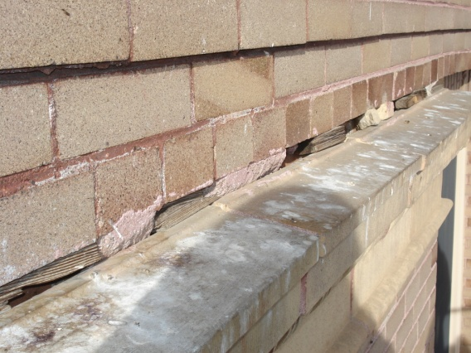
Montana University System Project Priority Ranking Guides
General Hierarchy of Project Priority Ranking Rationale
Health and Life/Safety
Major Maintenance of Building/Utility Systems
Code Compliance
Operational Efficiency/Savings
Adaptive Renovation
New Construction
Planning (Preliminary Design, Construction Estimates)
Authority Only

Slide 6
MUS LRBP BOR May 24-25, 2012 For 2015 Biennium
 |  | Work in Progress
 |  | LONG RANGE BUILDING PROGRAM
 |  | 2015 BIENNIUM
 |  |  |  |  |  |  | MSU | UM
Priority | Description |  |  |  |  |  | Amount | Amount
1 | Deferred Maint - MUS Roofs (MSU Great Falls & UM All Campuses) |  |  |  |  |  | $ 3,700,000 | $ 1,136,265
2 | MUS Code/Deferred Maint. |  |  |  |  |  | 3,000,000 | 3,000,000
3 | UM Missoula - College of Technology - New Facility South Campus |  |  |  |  |  |  | 47,000,000
4 | MSU Billings - Health & Science Building - Renovation & Addition |  |  |  |  |  | 14,750,000
5 | MSU Northern Havre- Auto & Diesel Tech Building - New Construction |  |  |  |  |  | 7,900,000
6 | MSU Bozeman - Renovate Romney Hall to Optimize Student Use |  |  |  |  |  | 20,000,000
7 | MT Agricultural Experiment Station - Greenhouse Upgrades |  |  |  |  |  | 1,500,000
8 | UM Western Dillon - Phase 3 Main Hall |  |  |  |  |  |  | 4,750,000
9 | MSU Bozeman - Classroom Renovations - Academic Buildings |  |  |  |  |  | 3,000,000
10 | MSU Billings - Library Renovation |  |  |  |  |  | 1,600,000
 | MT Tech of UM Butte - Natural Resource Research Center Addition |  |  |  |  |  |  | 10,000,000

Slide 7
Montana University System LRBP Process
Rigorous Process
Broad participation
Reasonable balance among MUS units over multiple Biennia
Adhere to Regents Priorities

Slide 8
Campus LRBP Process
Information Sources:
Capital Project Database
FCI – Deficiency Reports
Major/Deferred Maintenance Lists
Prior LRBP Lists
Energy Conservation Lists
Adaptive/Renovation Needs
New Construction Needs
University Master Plan

Slide 9
Chronological UM Appropriations 2001-2015
UM State Appropriated Cash & Bond LRBP Funds
Legislative | Missoula |  | Butte |  | Dillon |  | Helena |  | Total
Session | $ | % | $ | % | $ | % | $ | %
56th (2000-2001) | $3,232,000 | 34.5% | $935,107 | 10.0% | $5,195,000 | 55.5% |  | 0.0% | $9,362,107
57th (2002-2003) | $6,595,014 | 86.1% | $478,448 | 6.2% | $190,750 | 2.5% | $395,000 | 5.2% | $7,659,212
58th (2004-2005) | $202,000 | 32.7% | $240,500 | 38.9% |  | 0.0% | $175,000 | 28.3% | $617,500
59th (2006-2007) | $9,183,925 | 33.7% | $10,157,400 | 37.2% | $272,185 | 1.0% | $7,655,500 | 28.1% | $27,269,010
60th (2008-2009) | $9,821,000 | 37.5% | $6,634,000 | 25.3% | $5,250,000 | 20.0% | $4,500,000 | 17.2% | $26,205,000
61st (2010-2011) | $4,284,960 | 29.0% | $1,542,480 | 10.4% | $7,139,760 | 48.2% | $1,832,800 | 12.4% | $14,800,000
62nd (2012-2013) | $320,000 | 60.4% | $210,000 | 39.6% |  | 0.0% |  | 0.0% | $530,000
63rd (2014-2015) | $29,000,000 | 76.3% | $5,000,000 | 13.2% | $4,000,000 | 10.5% |  | 0.0% | $38,000,000
Total Funds | $62,638,899 | 50.3% | $25,197,935 | 20.2% | $22,047,695 | 17.7% | $14,558,300 | 11.7% | $124,442,829
State Supported FCI SqFt | 2,473,541 | 69.3% | 653,646 | 18.3% | 263,939 | 7.4% | 182,362 | 5.1% | 3,573,488
Cost Replacement Value | $587,175,889 | 69.2% | $161,499,732 | 19.0% | $62,356,299 | 7.3% | $37,916,162 | 4.5% | $848,948,082
Student FTE (2013) | 12,830 | 71.8% | 2,505 | 14.0% | 1,439 | 8.0% | 1,103 | 6.2% | 17,877

